Slide 1
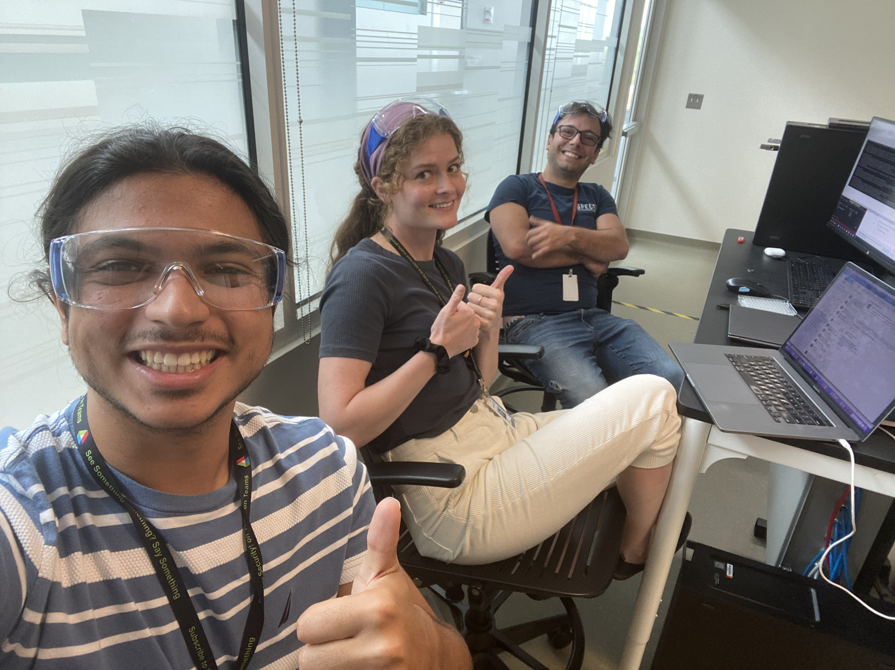
7/5/2023 Updates:
Hidex client finally works in 12–hour run! – Filtered IP address of anything in socket but Potts
Created master Excel document structure for scientists to prepare their run
Read Excel document data into Multi-Loop Run payload
Scientists’ Perspective on Growth Assay
How will they be starting the run?
Is there a website they will input their desired culture and media combinations or is Excel template fine?
Will we need to be able to search for previous runs?
On Globus/On Local Computer?
How would our barcoding look like? Should ID names for files indicate the time of experimental run start?
What features would we want to incorporate within the structure of our experiment?
Future Goals:
Run single-well plate experiment with cells
Fix positioning on Hudson Solo Index 2
Run 6 well plate on experiment setup and updated Excel structure
Incorporate VERY BASIC placeholder AI model into code structure
When the HIDEX finally runs a 12-hour test
Alp Demirtas

